Slide 1
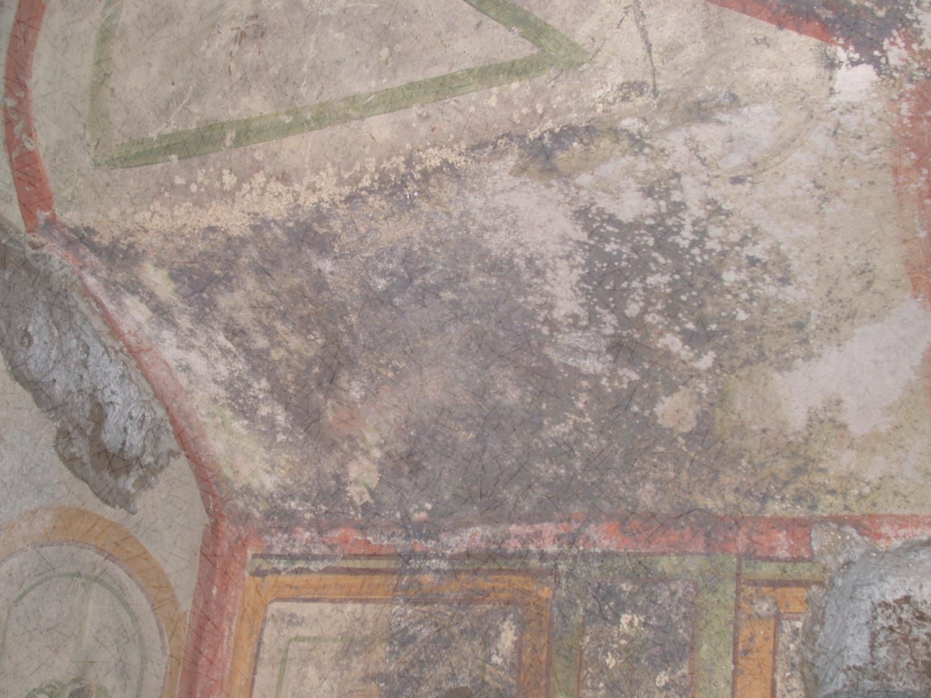
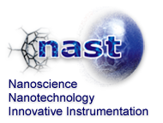
BIOSYSTEMS, ENERGY, AND CULTURAL HERITAGE:
MATERIALS ENHANCEMENT FOR TECHNOLOGICAL APPLICATION
July 3rd, 2013
A multidisciplinary approach for the conservation and valorization of Cultural Heritage
Bruno Laura
University of Rome “Tor Vergata”, Department of Biology
laura.bruno@uniroma2.it

Slide 2
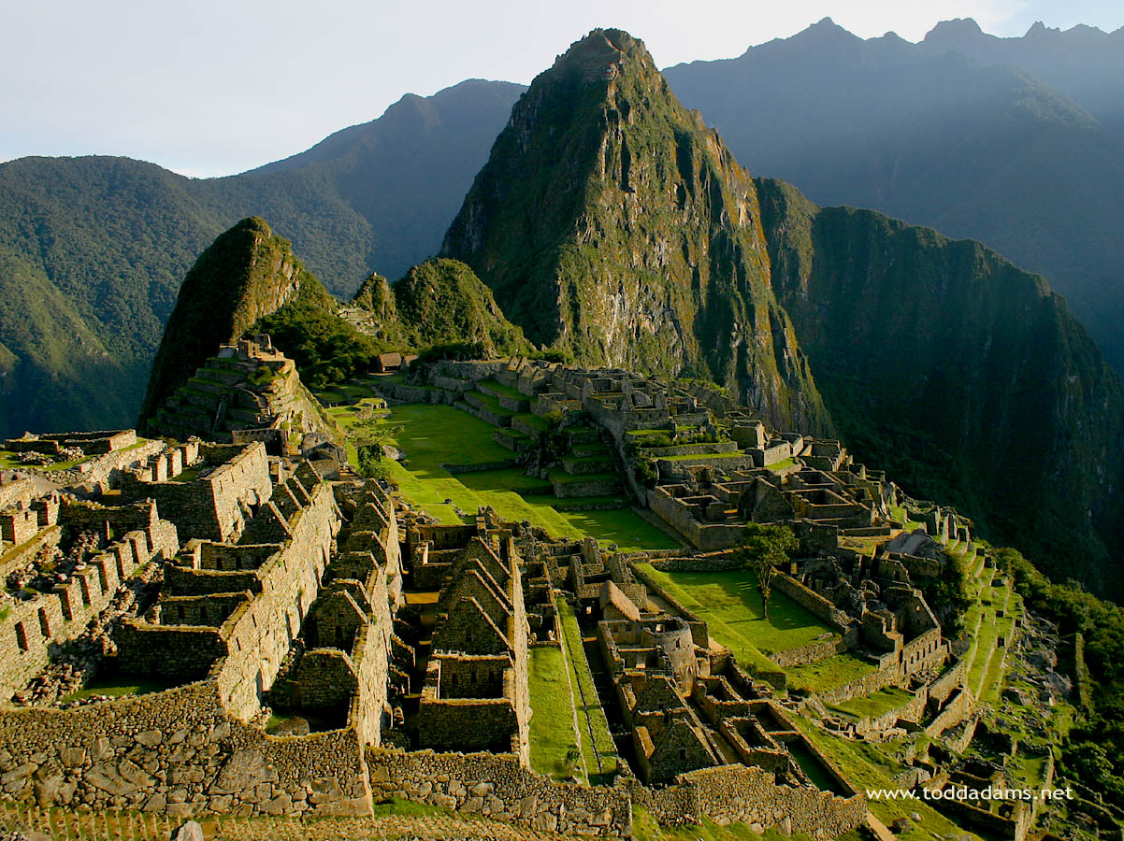
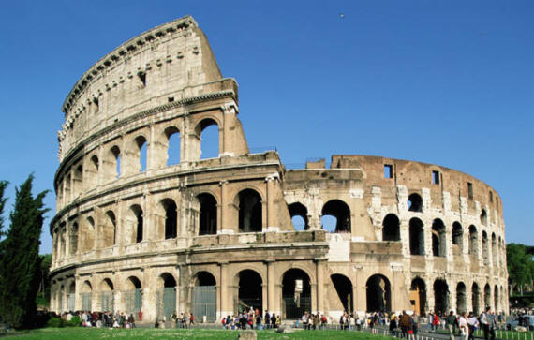
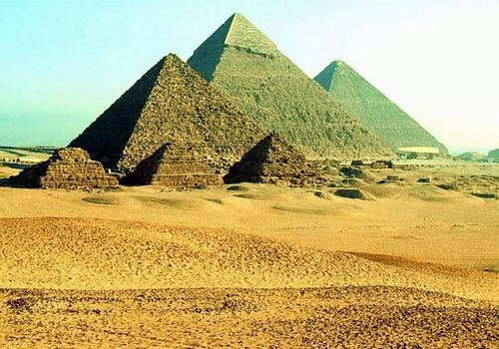
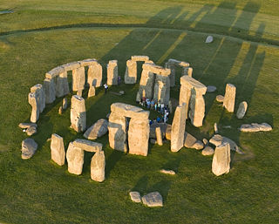
WORLDWIDE FAMOUS CULTURAL HERITAGE
Notes:
Stone monuments are an important part of our cultural heritage that witness the human history, past behaviour, social life and arts. Besides the well known archaeological sites that attract every days thousand of tourists

Slide 3
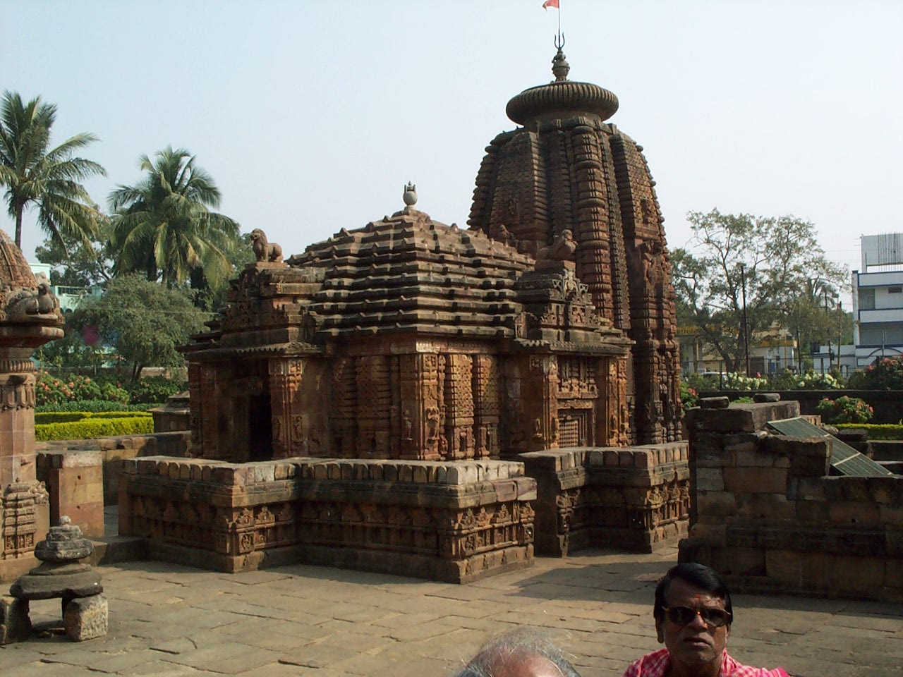
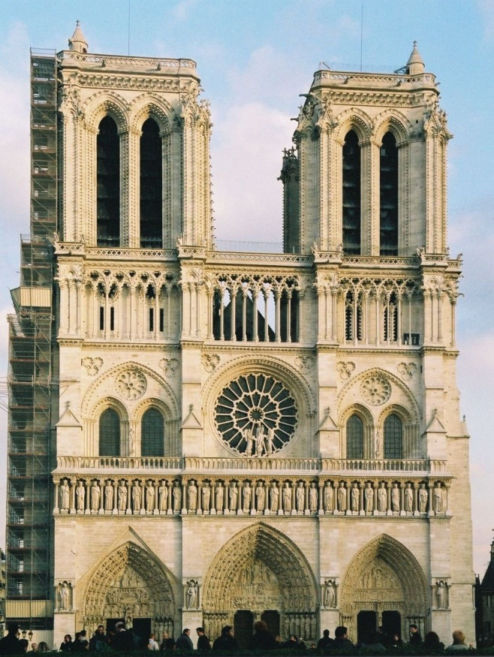
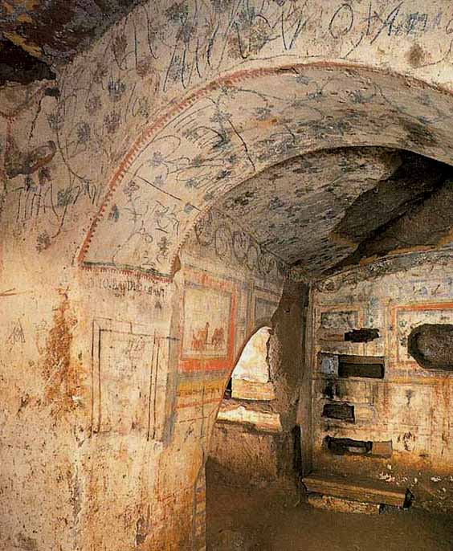
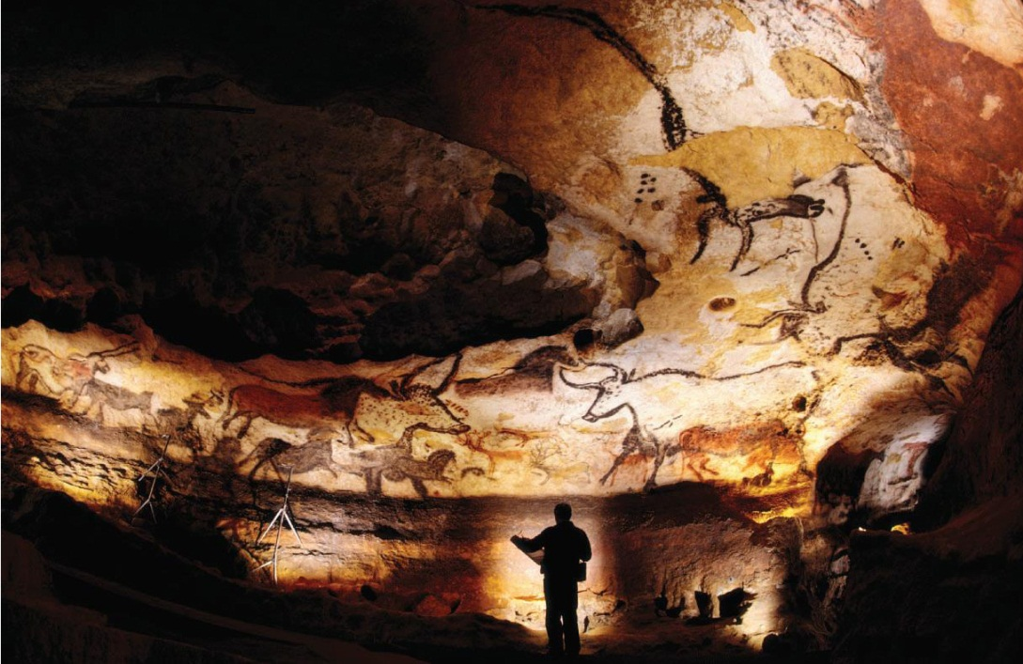
?
Notes:
other stone monuments spread worldwide represent our cultural treasure and many more are still to be discovered

Slide 4
CULTURAL HERITAGE RISKS OF DETERIORATION
ABIOTIC FACTORS
Physical or mechanical (disgregation, fracturation …)
Chemical (transformation, decomposition…)
BIOTIC FACTORS
Growth of microorganisms (aesthetic, structural damages)
Human impact (tourist influence, management activities..)
CLIMATE CHANGE EFFECT
Atmospheric moisture change
Temperature change
Sea-level rises
Wind
Desertification
Climate and pollution acting together
Notes:
All these cultural heritage are subjected to different risks of deterioration that could be divided in 2 main groups: the abiotic factors, physical, mechanical or chemical that can cause disgregation, fracturation, stone material transformation or decomposition; the biotic factors are an important threat of deterioration due to the growth of microrganisms on the stone surfaces that, at first, cause aesthetic problems and in a longer period could induce structural problems due to the metabolic activity of the microbes. Moreover, the human impact represents a high deteriorating risk due to the presence of the tourists that influences the climatic condition of the sites and are vehicles of transportation of spores and microbes and to the management activity needed to allow the tourists visits, such as the installation of artificial lights. An important point to be considered is the global climate change that can seriously jeopardize our cultural heritage. Think for example to the deterioration of the monument's facades for thermal stress or biochemical deterioration due to the temperature change or to the prevision of high risk of submersion of important cultural sites such as Venice as a result of the sea-level rise.

Slide 5
LEVELS OF DETERIORATION
Local climate conditions
Type and composition of stone materials
Receptivity of the substrata
Exposure to weathering factors
Human presence
Extension of biological colonization
Notes:
The intensity of the deterioration depends from many factors as the ….. Thus for the preservation of these monuments a combination of different expertise is needed

Slide 6
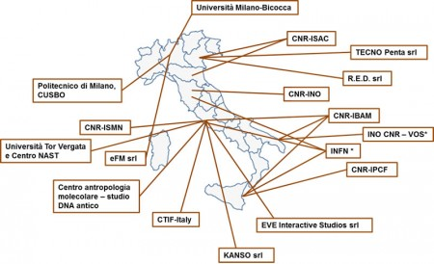
COIRICH: Consortium of Italian Research Infrastructure for Cultural Heritage
a distributed infrastructure, part of IRICH, which operates in the area of science and technology applied to the Cultural Heritage nationally and internationally, for the non destructive analysis of artistic materials of historical interest.
Provides access to end-users at the scientific instrumentation available in the laboratories ;
Enhances the know how exchange between participants;
Contributes to the definition of International standards in the field of conservation and analysis of the Cultural Heritage and the related research;
Promotes research and development of projects in the field of Cultural Heritage at regional, national and international levels, also through the application for national and UE financial support;
Italian networks laboratories
Notes:
A way to combine expertise and Technologies has been obtained by means Coirich, a consortium of Italian Research Infrastructure which operates in the area of science and technologies applied to the Cultural Heritage at a national and international level. Among the different aims it provides the access to the instrumentation available in the various laboratories, enhances the exchange of know how between participants and promotes research and development of projects in the field of Cultural Heritage.

Slide 7
DIAGNOSIS
MONITORING
PRESERVATION
VALORISATION
CULTURAL HERITAGE
PHYSICS
MICROBIOLOGY
ANTHROPOLOGY
PALEOBOTANY
CHEMISTRY
Notes:
As Coirich we have applied project for EU financial support with the idea of a multidisciplinary study aiming at the diagnosis, monitoring, preservation and evaluation of different sites of high cultural value with the employment of innovative and non-destructive techniques in the fields of physics, microbiology, anthropology, paleobotany and chemistry. Interdisciplinary collaboration in fact, allows a full vision of the Cultural Heritage under study.

Slide 8
NAST CENTER
Prof. Andreani, Prof. Picozza:
Imaging and logging with light and particle probes.
Muon transmission and muon scattering tomography
Neutron logging
Geophysical techniques will be integrated with muon transmission and scattering tomography and neutron logging to localize underground buried objects that will then be analysed by neutron and X-ray techniques.
Artifacts characterization
- Neutron-based techniques
Notes:
One of this collaboration within the NAST center is with the team of Professor Picozza and Andreani where are present expertise related to the development of muon tomography and neutron logging, new methodologies that are proposed for innovative application in the field of Cultural Heritage in order to localize and characterize underground buried objects, as Giulia Festa will explain later this evening in her presentation

Slide 9
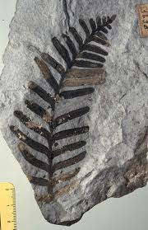
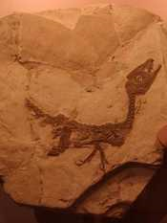
Ancient DNA
The term ancient DNA (aDNA) was used to describe the genetic material preserved in ancient biological remains.
Genetic analysis of fossil samples can provide, support and extend essential information about the human past, archaeological site interpretations and the development of higher level hypothesis.
Notes:
Another approach is the study of ancient DNA from bones or seeds collected in the site investigated. The analysis of ancient DNA provides archaeologists and anthropologists with innovative, scientific and accurate data to study and understand the past.

Slide 10
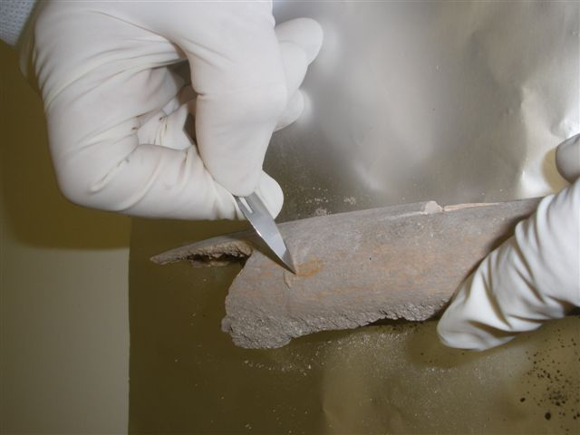
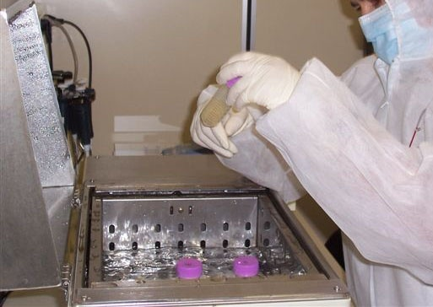
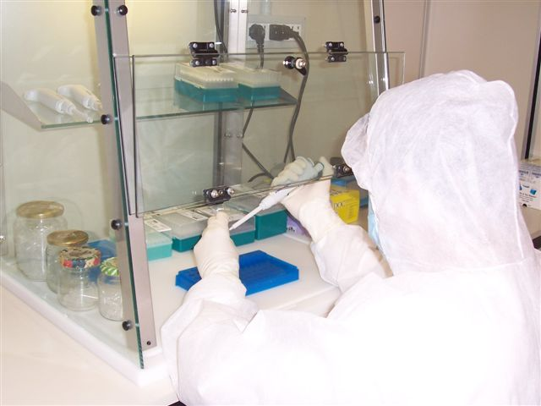
Prof. Rickards
Analysis of ancient biomolecules
bone sample pre-treatment
MOLECULAR CHARACTERIZATION OF HUMAN REMAINS
To relate the genetic and cultural changes that have occurred in the populations that have inhabited the sites investigated to their subsistence strategies, state of health, social complexity and environment in order to reconstruct their past history
sampling
DNA extraction
PCR setting
Notes:
This was obtained in collaboration with the team of Prof. Rickards that carried out analysis of ancient biomolecules, as just explained in the previous presentation by Roberta Lelli. The molecular characterization of human remains allow to relate the genetic and cultural changes that have occurred in the populations that have inhabited the sites investigated to their subsistence strategies, state of health, social complexity and environment in order to reconstruct their past history

Slide 11
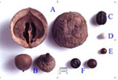
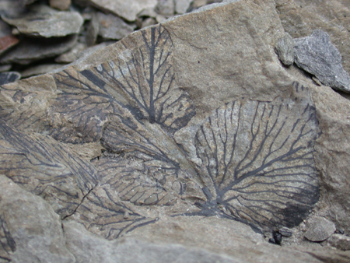
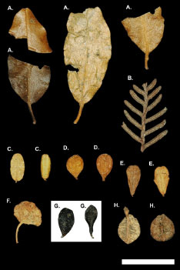
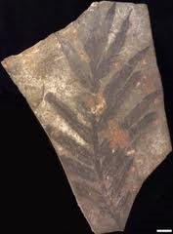
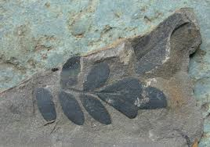
Prof. Canini: plant aDNA information
Past plant uses
Customes
Agriculture
Diet
Past economy
Migrations
Trades
Vegetation and biogeography
Ecology and paleoclimatology
Plant evolution
Notes:
Moreover, by studying the plant ancient DNA, carried out by the team of Prof. Canini it is possible to obtain information about past plant uses customes, agriculture, diet, economy, migrations, trades, vegetation, biogeography, ecology, plant evolution and even past palaeoclimatology

Slide 12
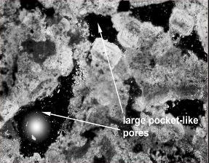
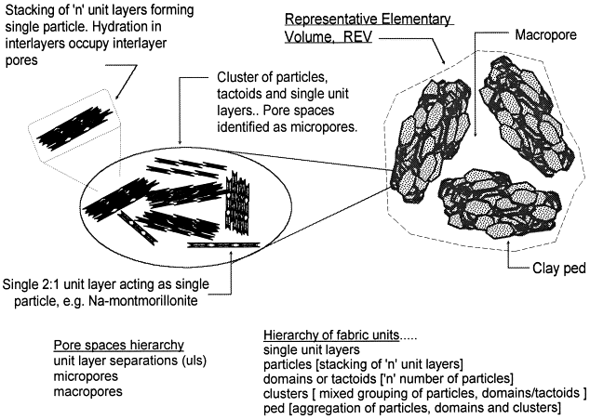
Nanomaterials for:
Consolidation; Restoration and Cleaning
Valentini, F., Carbone, M., Palleschi, G.,
Nanomaterials applied in medicine, cultural heritage and chemical sensor technology,
2013, International Journal of Nanotechnology 10 (5-7) , pp. 508-522
Nano CaCO₃
Nano Ca(OH)₂
Chemistry Department, Tor Vergata University, Rome
Dr. F. Valentini, Prof. G. Palleschi
Notes:
Another fruitful collaboration in the field of Cultural Heritage is the one with Federica Valentini and Professor Palleschi who synthesise environmentally sustainable Nanomaterials, suitable for consolidation , restoration , cleaning and protection of historical surfaces affected by dark patinas and biofilms

Slide 13
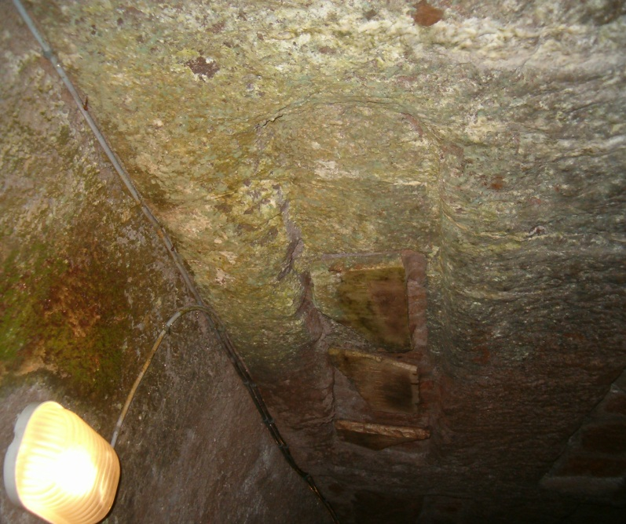
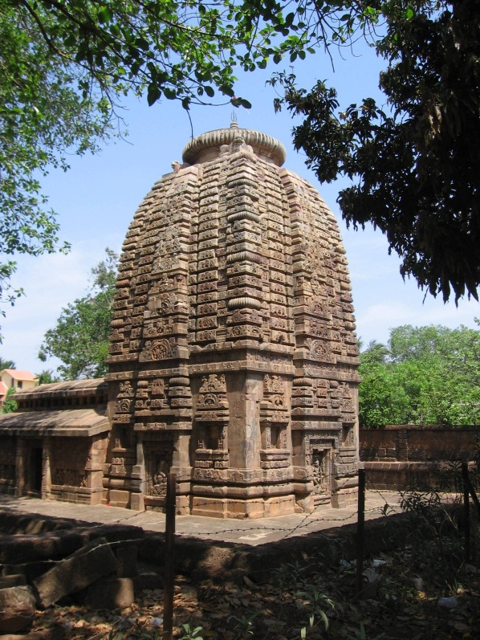
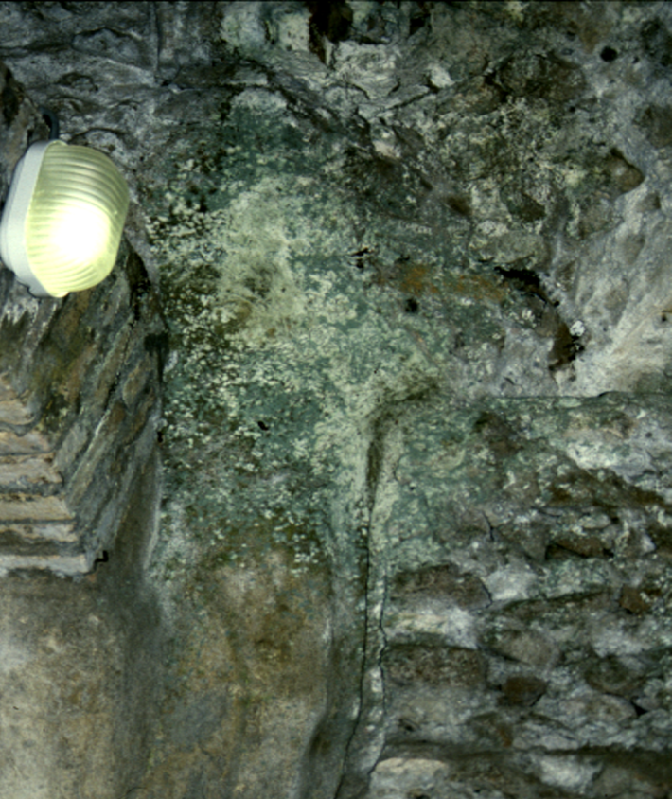
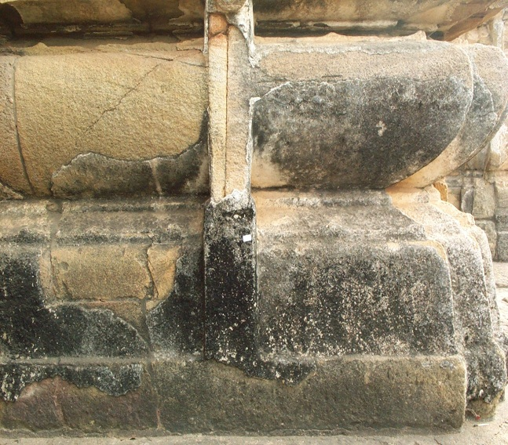
BIODETERIORATION PROCESSES ON STONE MONUMENTS BY PHOTOTROPHIC BIOFILMS
Dr Laura Bruno: Laboratory of Biology of Algae
outdoor
indoor
LBA
Notes:
Stone monuments suffer very frequently of biodeterioration problems due to the growth of phototrophic biofilms on the exposed lithic surfaces both in indoor and outdoor environments.

Slide 14
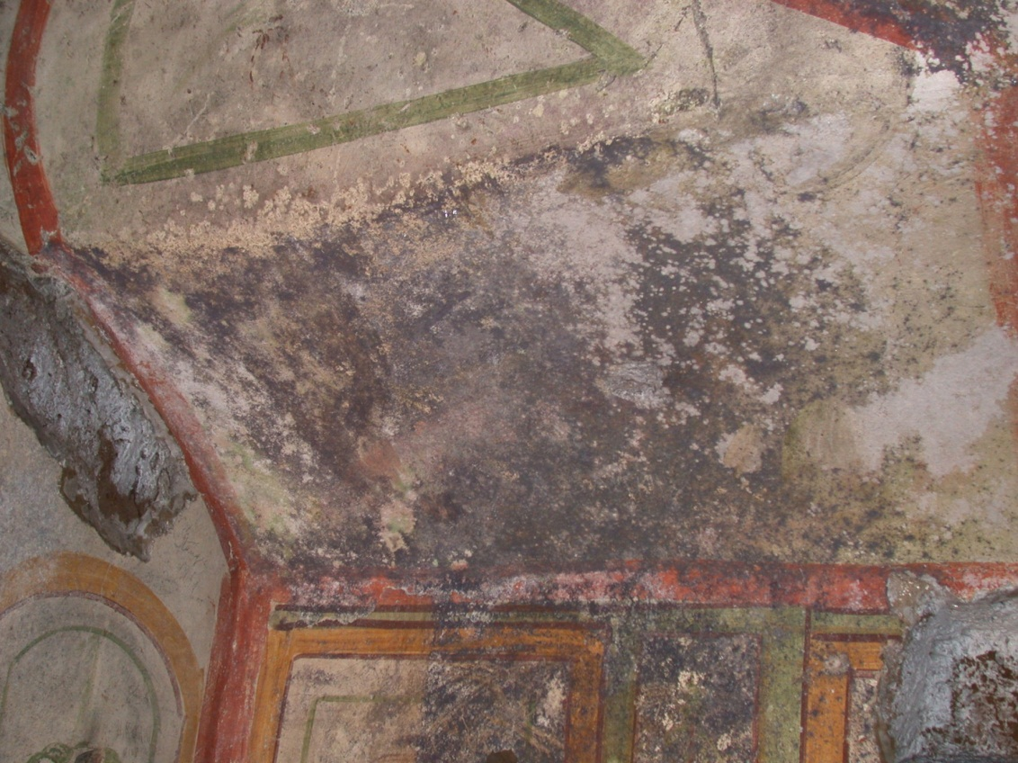
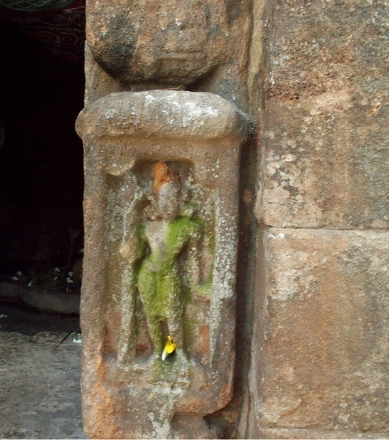
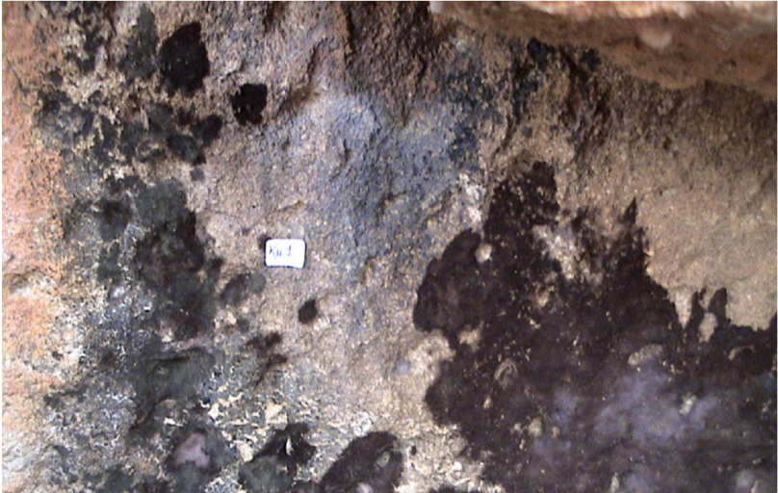
LBA
AESTHETIC AND STRUCTURAL PROBLEMS
Due to the growth of
Subaerial lithophitic photoautotrophic and associated heterotrophic microorganisms on stone monuments
Notes:
The growth of these microbial consortia on the exposed lithic faces caused aesthetic problems on the monument surfaces that are often interested by a huge colonization that cause discoloration and a total covering of the underlying paintings. In the longer time the metabolic activity of the microorganism induced also structural problems to the underlying substrata

Slide 15
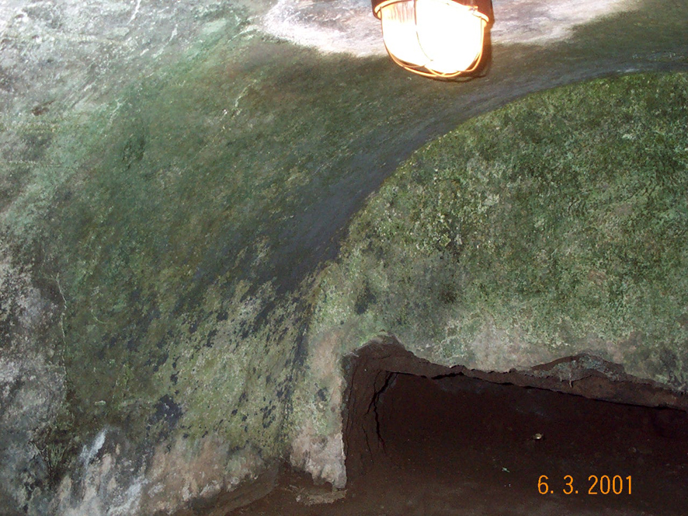
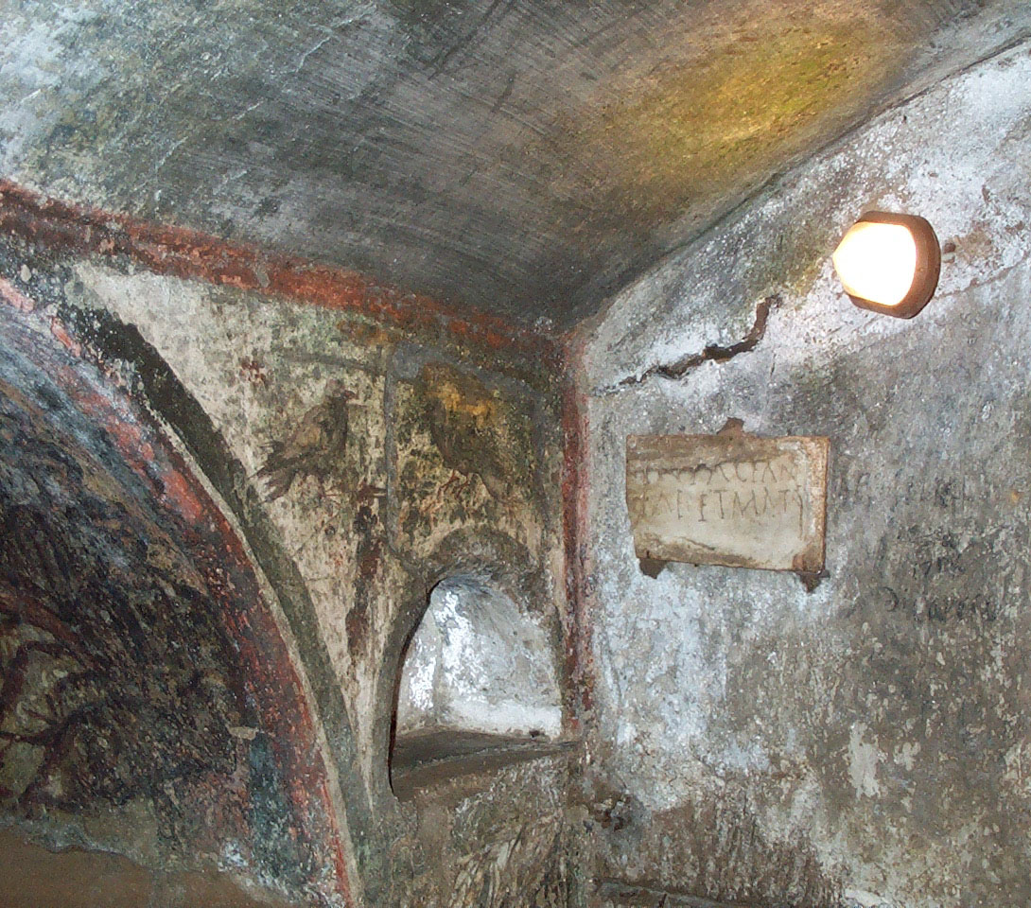
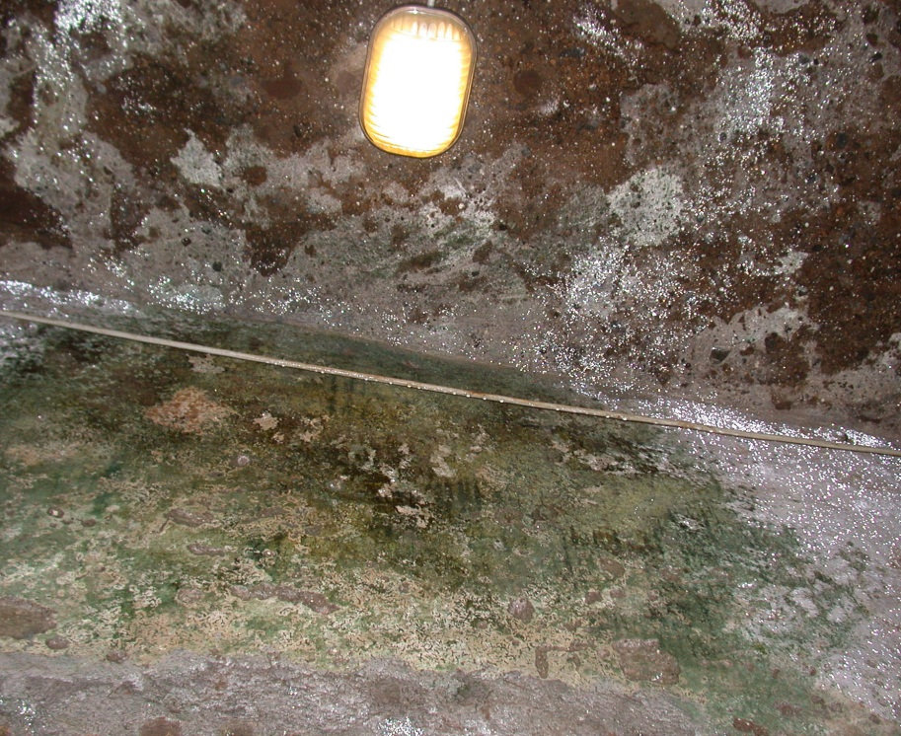
Christian Catacombs (Rome, Italy)
RH > 88%
T ~ 18 °C
PAR < 2 μmol m⁻² s⁻¹
LBA
Notes:
In roman hypogea like the Catacombs of Rome, the peculiar climatic conditions sustained the development of microbial biofilm on walls and paintings; the light is the key factor for the growth of phototrophic microorganisms and in these environments the artificial illumination needed for the tourists visits, although at very low intensities, less than 2 umol of photon per meter square per second, supports the development of the phototrophic biofilms on the illuminated sites

Slide 16
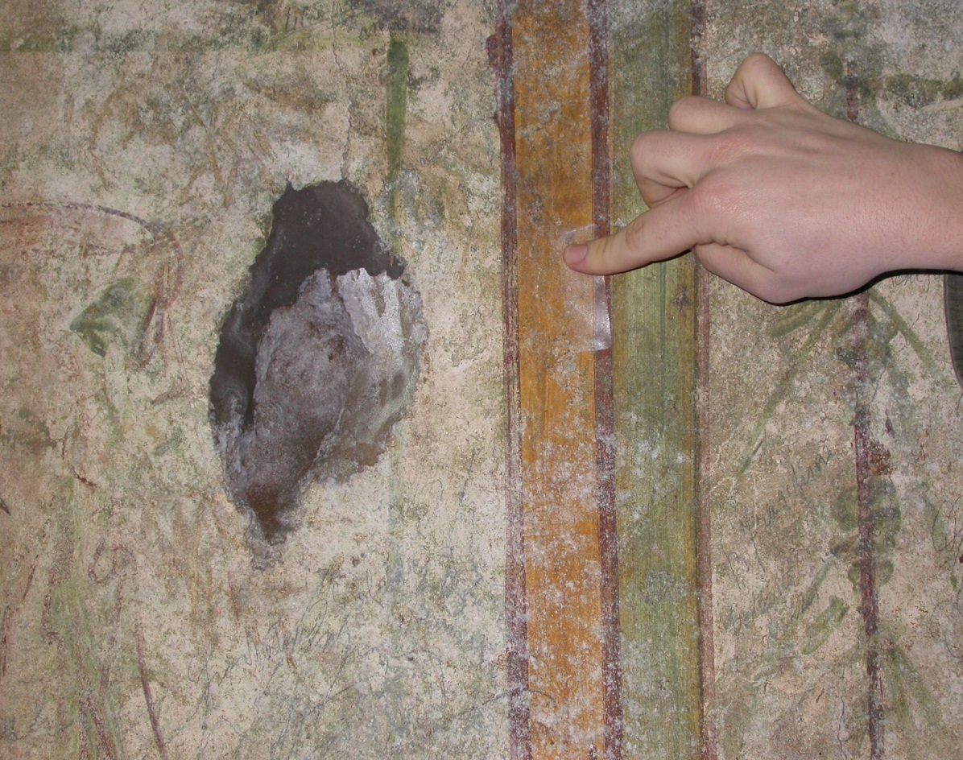
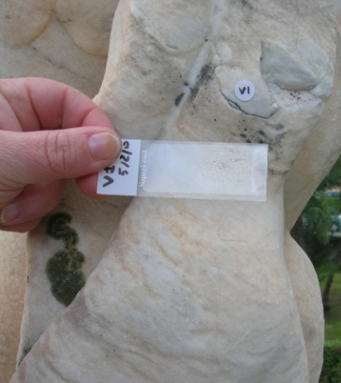
LBA
Non-Destructive and Non-Invasive Techniques:
Adhesive tape method (MAT)
Adhesive tape method offers the possibility to collect surface microorganisms and to get information on their morphology, spatial distribution and relationships with the colonized rock material directly during the observation with different microscopes
Notes:
In order to characterize the phototrophic communities growing on these valuable surface we use non destructive and non invasive techniques to carry out the sampling. The Adhesive tape method offers the possibility to sample surface microorganisms and to get information on their morphology, spatial distribution and relationships with the colonized rock material directly during the observation under different microscopes

Slide 17
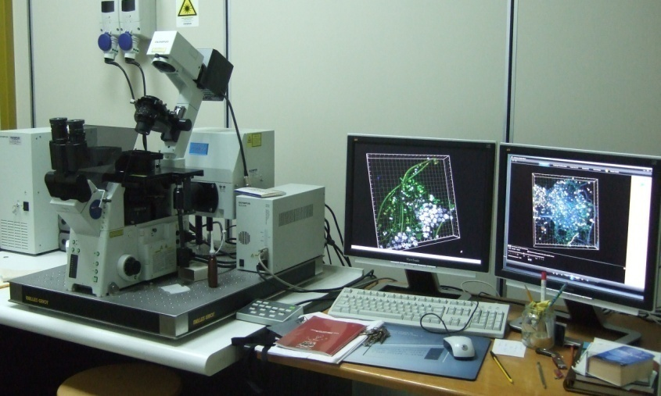
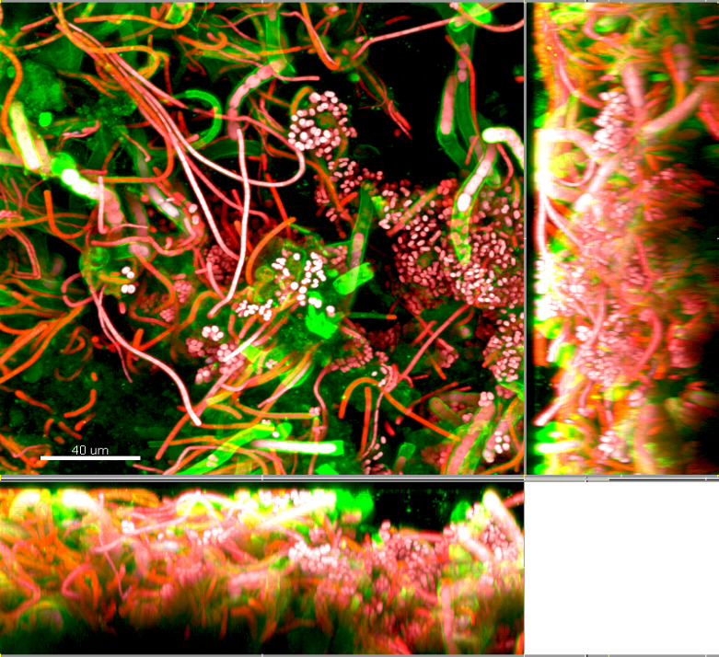
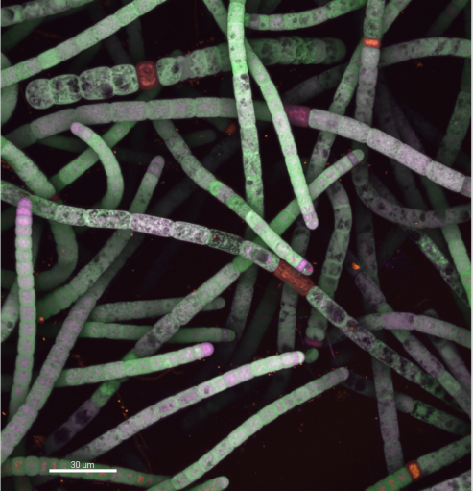
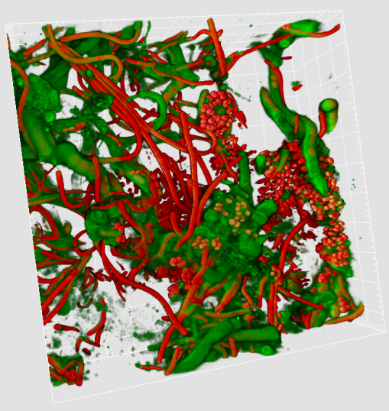
CAM-Center of Advanced Microscopies ‘Patrizia Albertano’
University of Rome Tor Vergata – Department of Biology
CLSM
Biofilm architecture shown by a bi-channel extended-focus projection (section mode) that allows lateral view in XZ and YZ of the community layering
Olympus Fluoview 1000 Confocal Laser Scanning System
LBA
CLSM images obtained by xyz acquisition and visualized in MIP (maximum intensity projection) mode; Laser excitation wavelength 488, 543, 635 nm
Notes:
A useful tool for this scope is the confocal laser scanning microscope, a facility presents at our department of Biology. With this microscope and thanks to the autofluorescence properties of phototrophic organisms growing on stone monuments it is possible to acquire bidimensional imaging of the biofilms by direct observation of the adhesive tape strip. As you can see in the images, it allows to investigate the biodiversity of this community and to understand the strict relationship among the different phototrophs present in the biofilm.

Slide 18
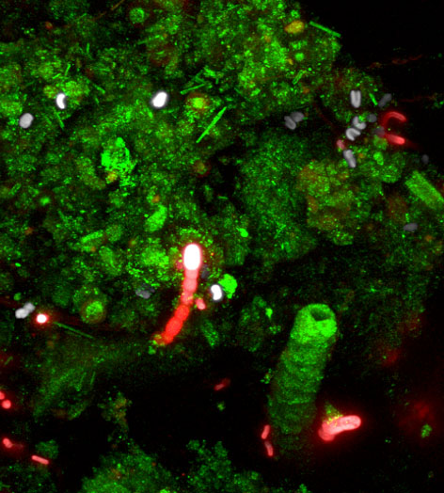
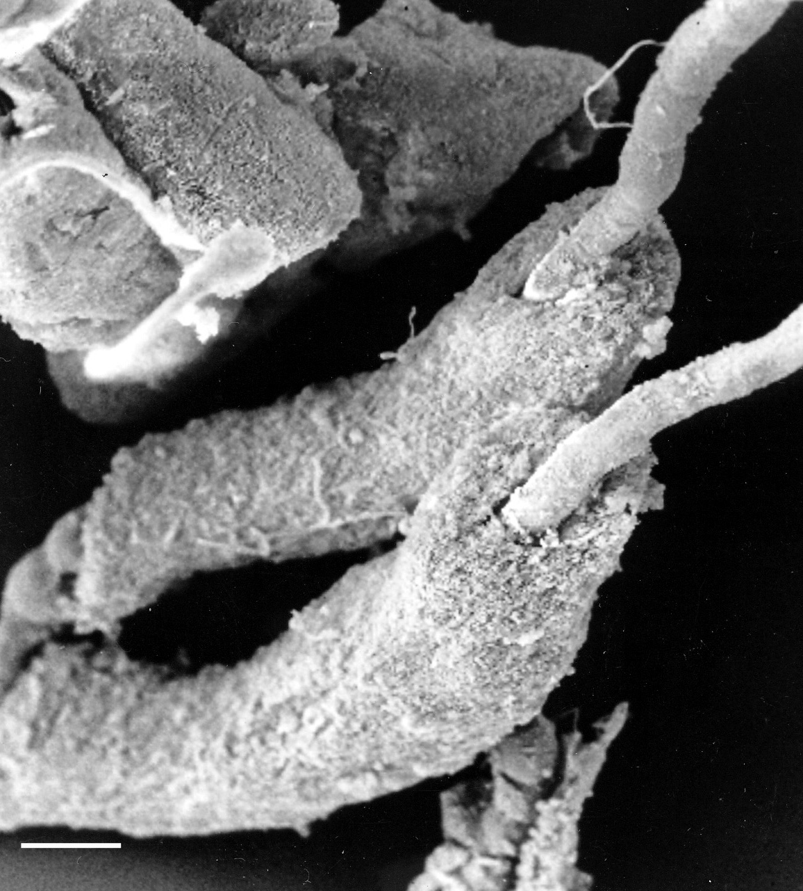
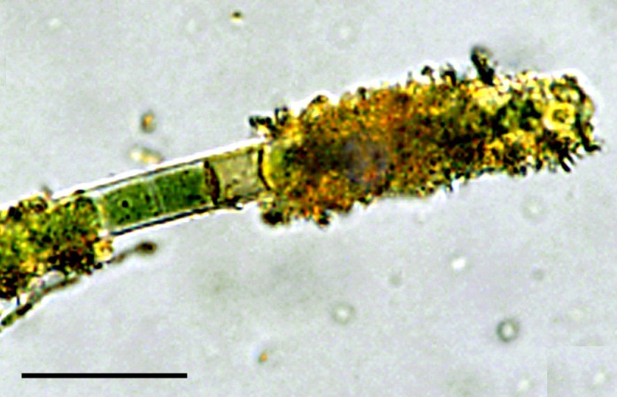
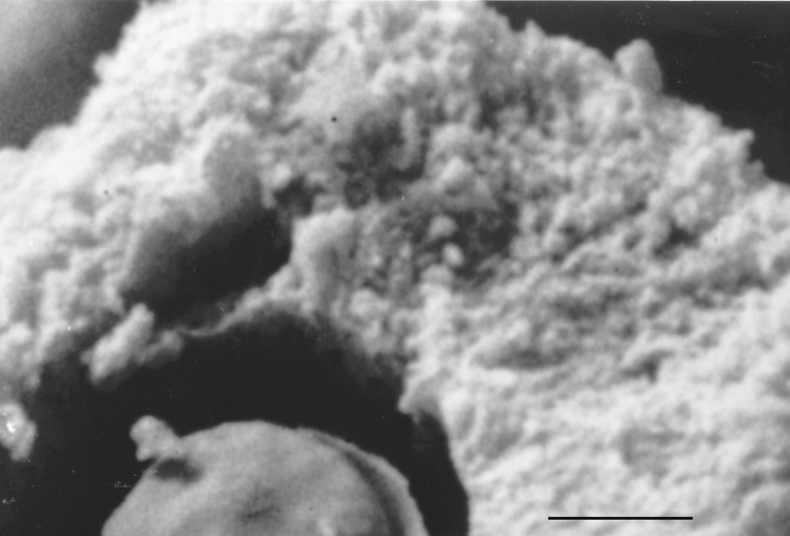
BIODETERIOGENIC SPECIES OF CYANOBACTERIA
30 μm
EPS
2 μm
Notes:
These studies showed that the biofilms are mainly composed by cyanobacteria along with bacteria, mosses and microalgae. Among the cyanobacteria there are some species highly biodeteriogenic due to their ability to precipitate calcium carbonate and other minerals by demineralization of the substratum and re-precipitation on their polysaccharidic sheaths. It is thus fundamental to widening the knowledge on the composition of the biofilms in order to apply specific preventive strategies to limit or deter the microbial growth on these valuable surface

Slide 19
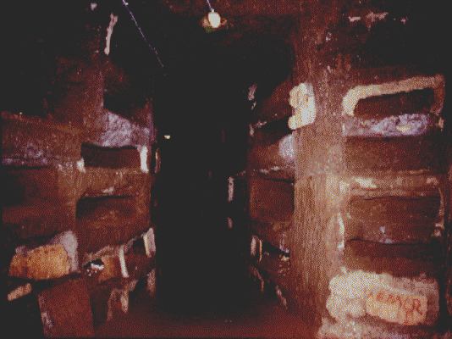
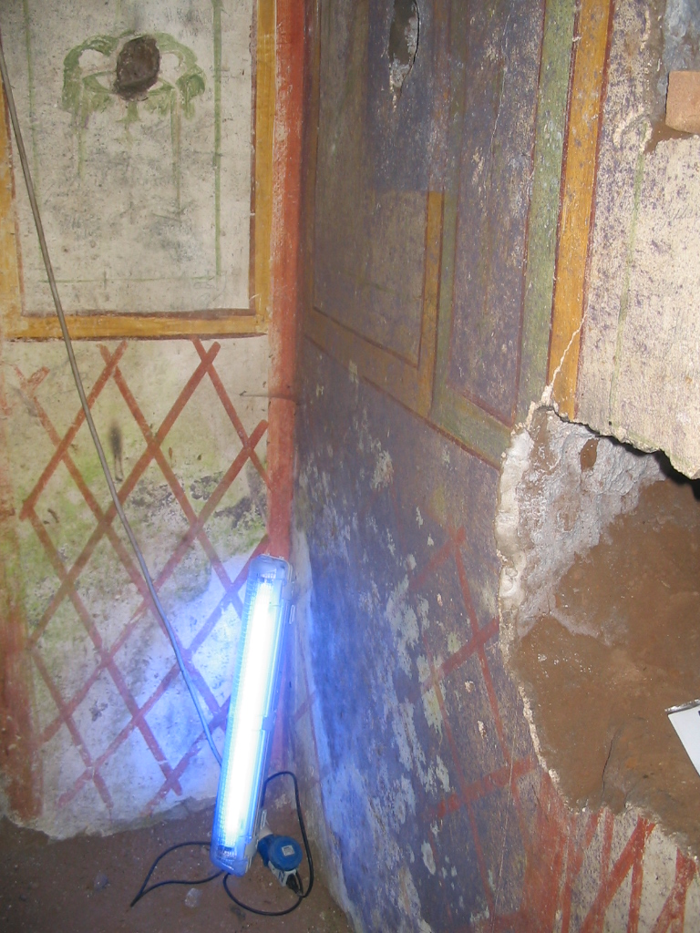
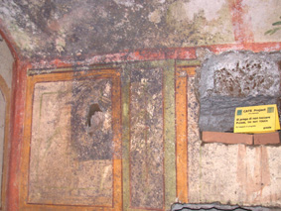
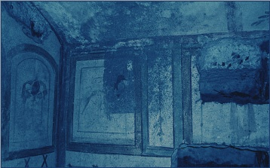
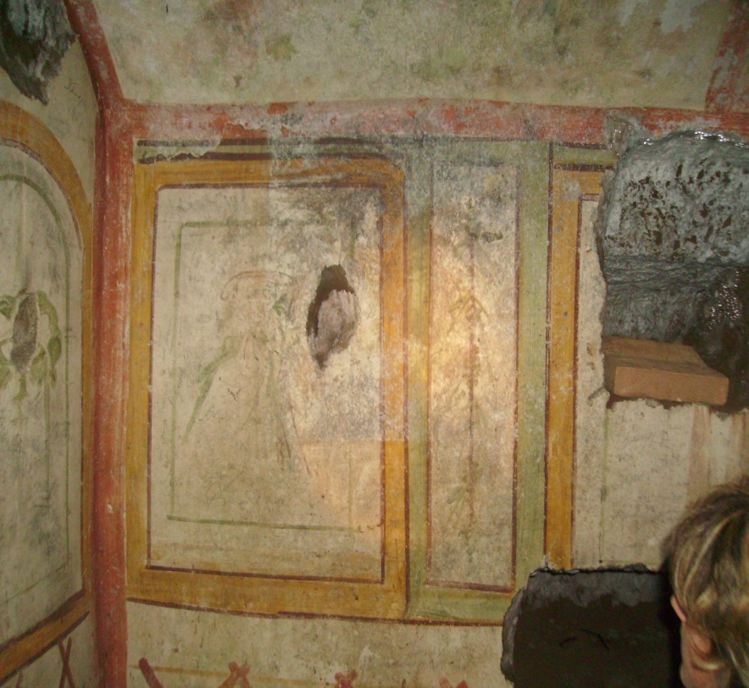
In situ monochromatic lamp
LBA
CATS
Notes:
In the frame of an EU project we tested monochromatic light as a preventive strategy to deter microalgal growth inside a Cubiculum in the Catacomb of s. Callistus. After the installation of a blue monochromatic lamp inside the cubiculum the phototrophic biofilms were not able to grow and disappeared from the painted surfaces

Slide 20
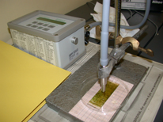
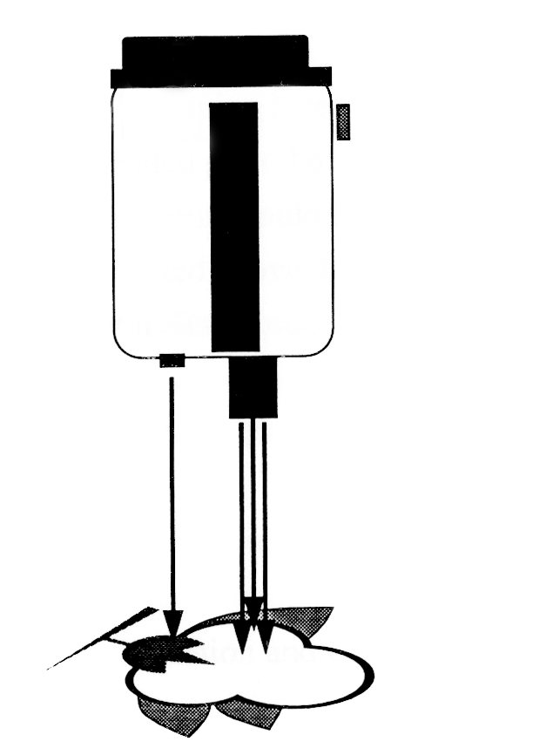
LBA
PORTABLE AND NON-INVASIVE INSTRUMENTATION APPLIED TO THE STUDY OF BIODETERIORATION OF CULTURAL HERITAGE
GER 1500
Laser
beam
Mini - PAM
Reference plate
Notes:
Portable and non invasive instrumentation are very useful to these studies such as the GER, a spectroradiometer that allow to characterize the light emission of the lamps present in hypogean sites and to understand how phototrophs use these irradiances for the photosynthetic processes or the minipam fluorometer that allow to monitor the photosynthetic activity during in situ and laboratory experiments

Slide 21
Laboratory of Biology of Algae – Spin off AlgaRes, Tor Vergata
Phototrophic biofilms collected in situ and tested in lab
diode-based illumination system a combination of monochromatic LEDs
to deter algal growth in indoor sites and to allow a better vision for tourists
PROTOTYPE
Notes:
With the employment of these instrumentation and in collaboration with a university spinoff that owned spectral cabinet we are now developing a prototipe of illumination by a combination of different monochromatic LED that at the same time deter algal growth and allow a better vision for tourists

Slide 22
CONCLUSION
DIFFERENT INNOVATIVE AND NON-INVASIVE TECHNIQUES CAN BE APPLIED TO THE STUDY OF CULTURAL HERITAGE
WE PROPOSE A MULTIDISCIPLINARY APPROACH INVOLVING STUDIES IN THE FIELDS OF PHYSICS, MICROBIOLOGY, ANTHROPOLOGY, PALEOBOTANY AND CHEMISTRY AS AN USEFUL TOOL FOR THE CHARACTERIZATION, PRESERVATION AND VALORISATION OF OUR CULTURAL HERITAGE
THANK YOU FOR YOUR ATTENTION!!
Notes:
In conclusion different innovative and non invasive techniques can be applied to the study of cultural heritage. A multidisciplinary approach involving studies in the field of physics, microbiology, anthropology, paleobotany and chemistry is an useful tool for the characterization, preservation and valorisation of our cultural heritage

